Slide 1
The Role of the Performance Testing Lab
External Dosimetry
Dave Jones
Dosimetry Performance Test Laboratory Administrator

Slide 2
The Role of the Performance Testing Lab
DOE Standard 1095 – Department of Energy Laboratory Accreditation Program for Personnel Dosimetry
  This standard establishes the technical basis for the Performance Testing Laboratory (PTL) that administers the external dosimeter program for DOE site dosimetry programs seeking DOELAP accreditation
  to ensure that the performance of personnel dosimetry programs are adequate to meet the requirements of Title 10, Code of Federal Regulations, Part 835, Occupational Radiation Protection and related documents

Slide 3
DOE Standard 1095
Criteria for Testing come from ANSI/HPS standards
Performance testing of whole body dosimeters is conducted in accordance with ANSI/HPS N13.11, American National Standard for Dosimetry – Personnel Dosimetry Performance
Performance testing of extremity dosimeters is conducted in accordance with ANSI/HPS N13.32 American National Standard for Performance Testing of Extremity Dosimeters

Slide 4
Updates to the Standards
Performance testing of whole body dosimeters is conducted in accordance with ANSI/HPS N13.11
The latest Revision was issued in December 2022
By now all dosimetry programs should have implemented the requirements and been tested/assessed to this version

Slide 5
ANSI N13.11-2022
Notable Changes
  Category VD is a new neutron category using ²⁴¹Am/Be source
    Not included in VA (General)
    Allows alternative to ²⁵²Cf
  Category II the “S” Special series x-ray beams, S60 & S75 have been removed from testing
  Category II clarifications on energy range irradiations
    At least 3 but no more than 5 Low energy <70 keV
    At least 3 Mid energy <70 – 500> keV
    At least 3 High energy, ¹³⁷Cs or ⁶⁰Co
    3-5 Angles and 5-10 Mixtures remain unchanged

Slide 6
ANSI N13.11-2022
New Appendices Added
  Appendix H – LLD Guidance that was removed from 2009 version has been added back in along with two alternate LLD methods
  Appendix I – Angular Response Study added back in and made consistent with guidance in ANSI N13.32
  Appendix J – Lens Of The Eye Dosimetry
VOID requirements expanded
  Only one void allowed per round
  When void occurs in rounds 1 or 2, participant may request replacement irradiation(s) in subsequent rounds (at discretion of the IL)

Slide 7
ANSI N13.11-2022
VOID requirements continued
  For any dosimeters that are voided without replacement irradiations, the participant shall retain objective evidence of the technical justification, and a succinct explanation of why the void was necessary shall be provided to the IL for inclusion in the summary report.
  All categories contain one (1) or more subcategories that require a minimum number of dosimeters to be exposed using a specified condition (e.g., irradiated at angles, under mixtures of radiation energies, within specific energy bounds, etc.). Under some conditions, voiding dosimeters may result in not reaching these minimum criteria. If this occurs, replacement irradiations shall suit the requirement of the subcategory to the extent possible.

Slide 8
Updates to the Standards
Performance testing of extremity dosimeters is conducted in accordance with ANSI/HPS N13.32. (2018)
No changes to sources and x-ray beam codes
Fixed table 4, Factors to convert from air kerma to shallow personal dose equivalent
  Ck conversion factors for Arm (Wrist) were incorrectly listed identical to Finger
  All ISO High air Kerma Series
  ISO Wide Series
  ISO Narrow Series
  NIST beam codes were correct in the 2008 version
Appendix D removed- documentation of switching from sum of bias and st dev to the L² ≥ B² + S² which aligned with the WB standard and is currently used

Slide 9
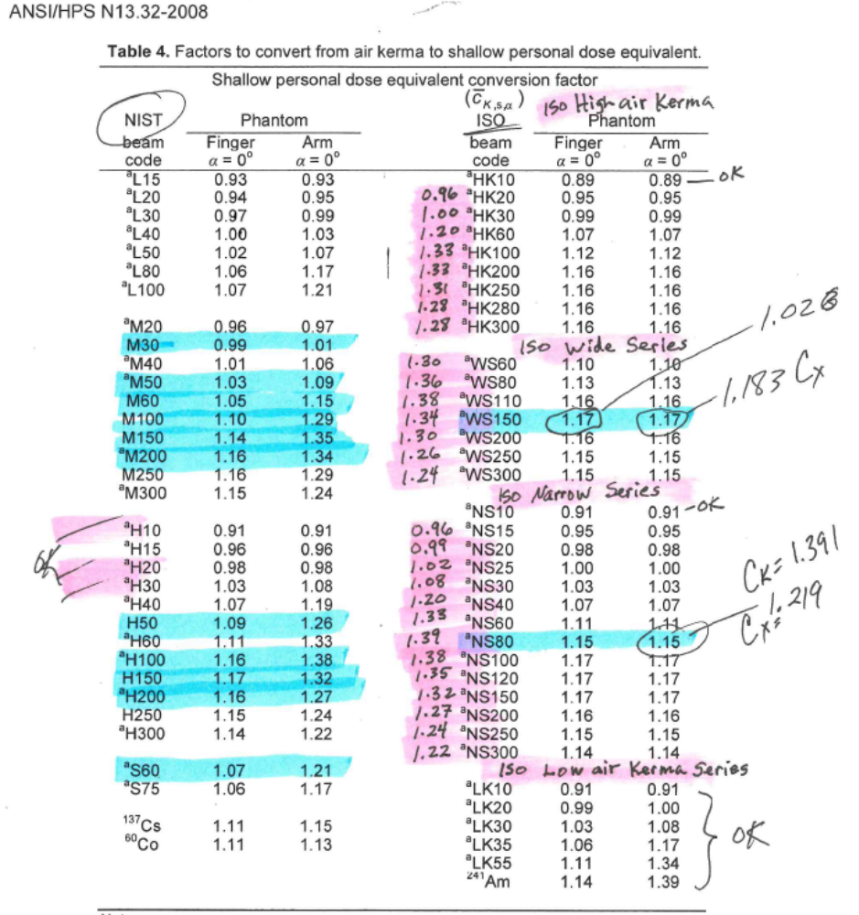

Slide 10
Updates to the Standards
The latest revision of the ANSI/HPS N13.32-2018 now allows a ‘non blind’ option for mixture categories. If you wish to pursue ‘non blind’ testing in the extremity categories it must be identified in your application and communicated to the DOELAP coordinator prior to testing.
Previously if you tested in the mixture category (IV) the whole test was ‘blind’ with respect to the source used for the irradiation. This made it nearly impossible to pass for dosimeters with a single element because there was no way to discriminate different energies (rings).
It was argued in the working group that specific projects, waste streams and most glove box work, the source term was well defined and thus the processor would know up front.
Passing testing ‘blind’ is a more robust test and demonstrates the technical capability of the dosimetry program.

Slide 12
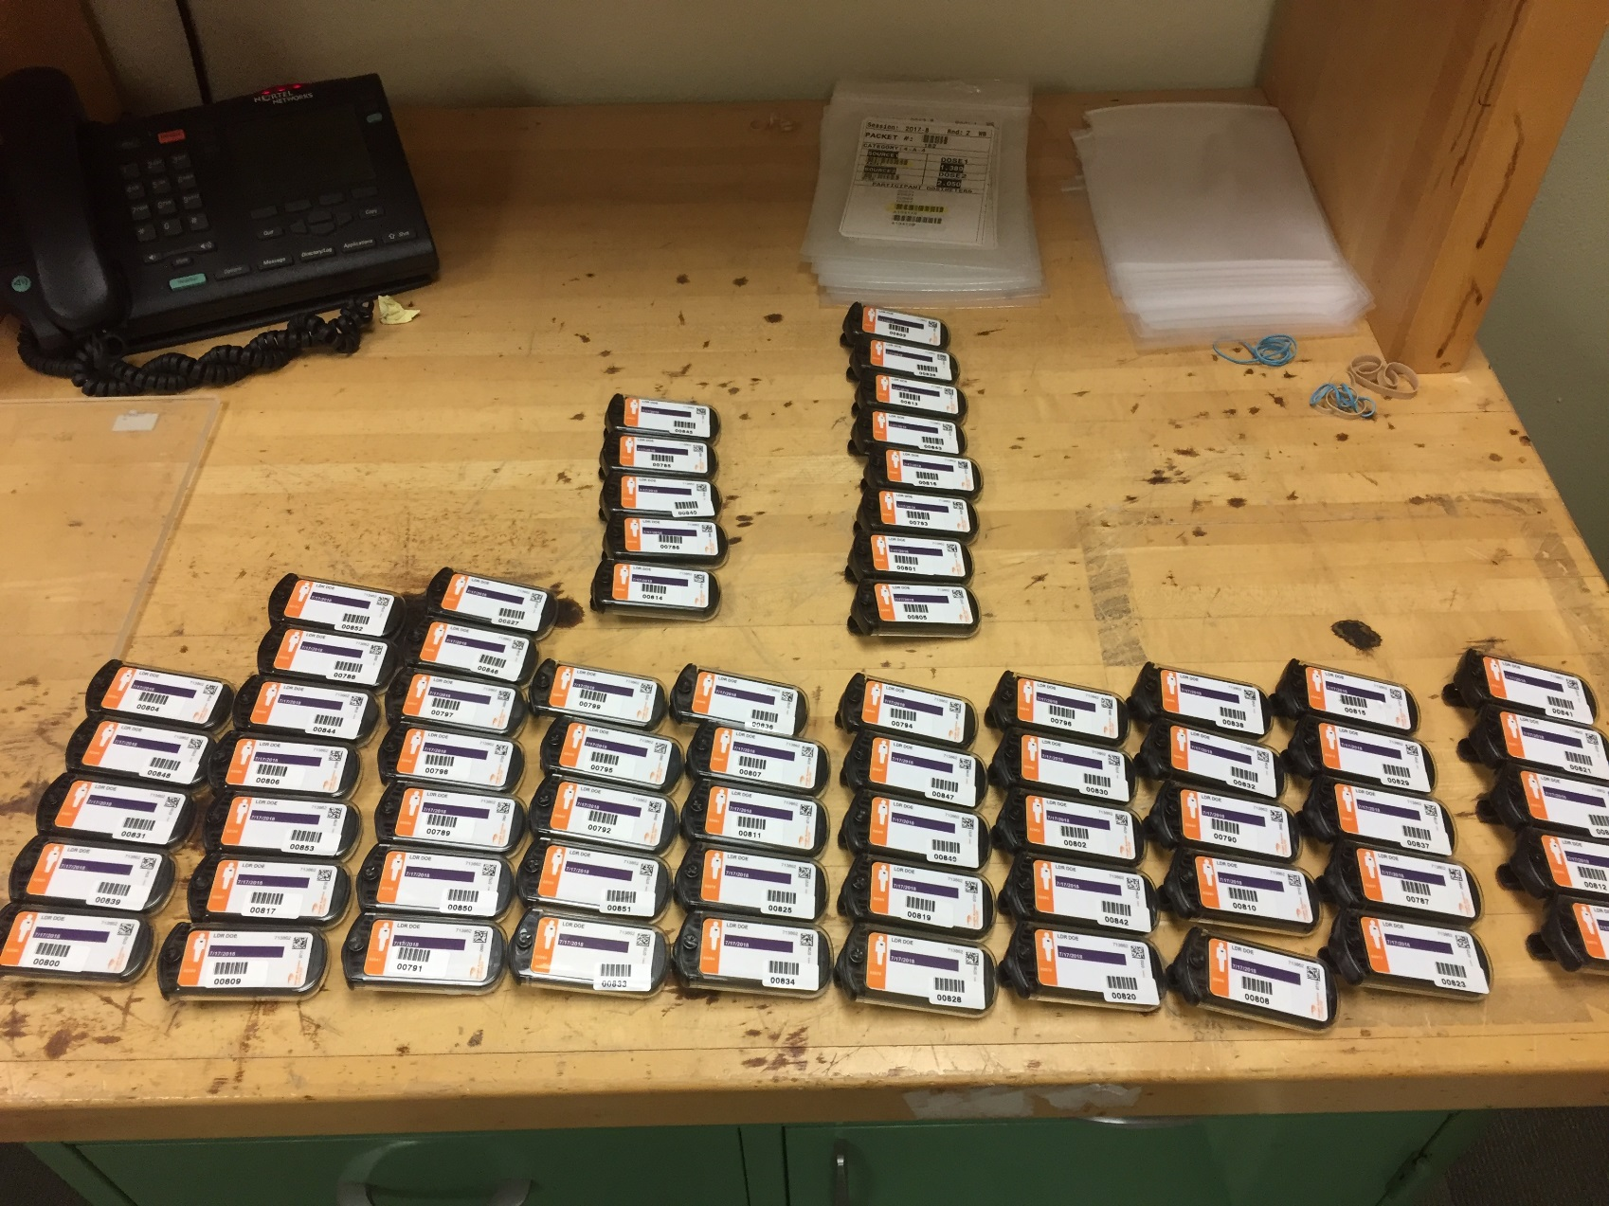
Receiving Dosimeters
Survey for contamination

Slide 13
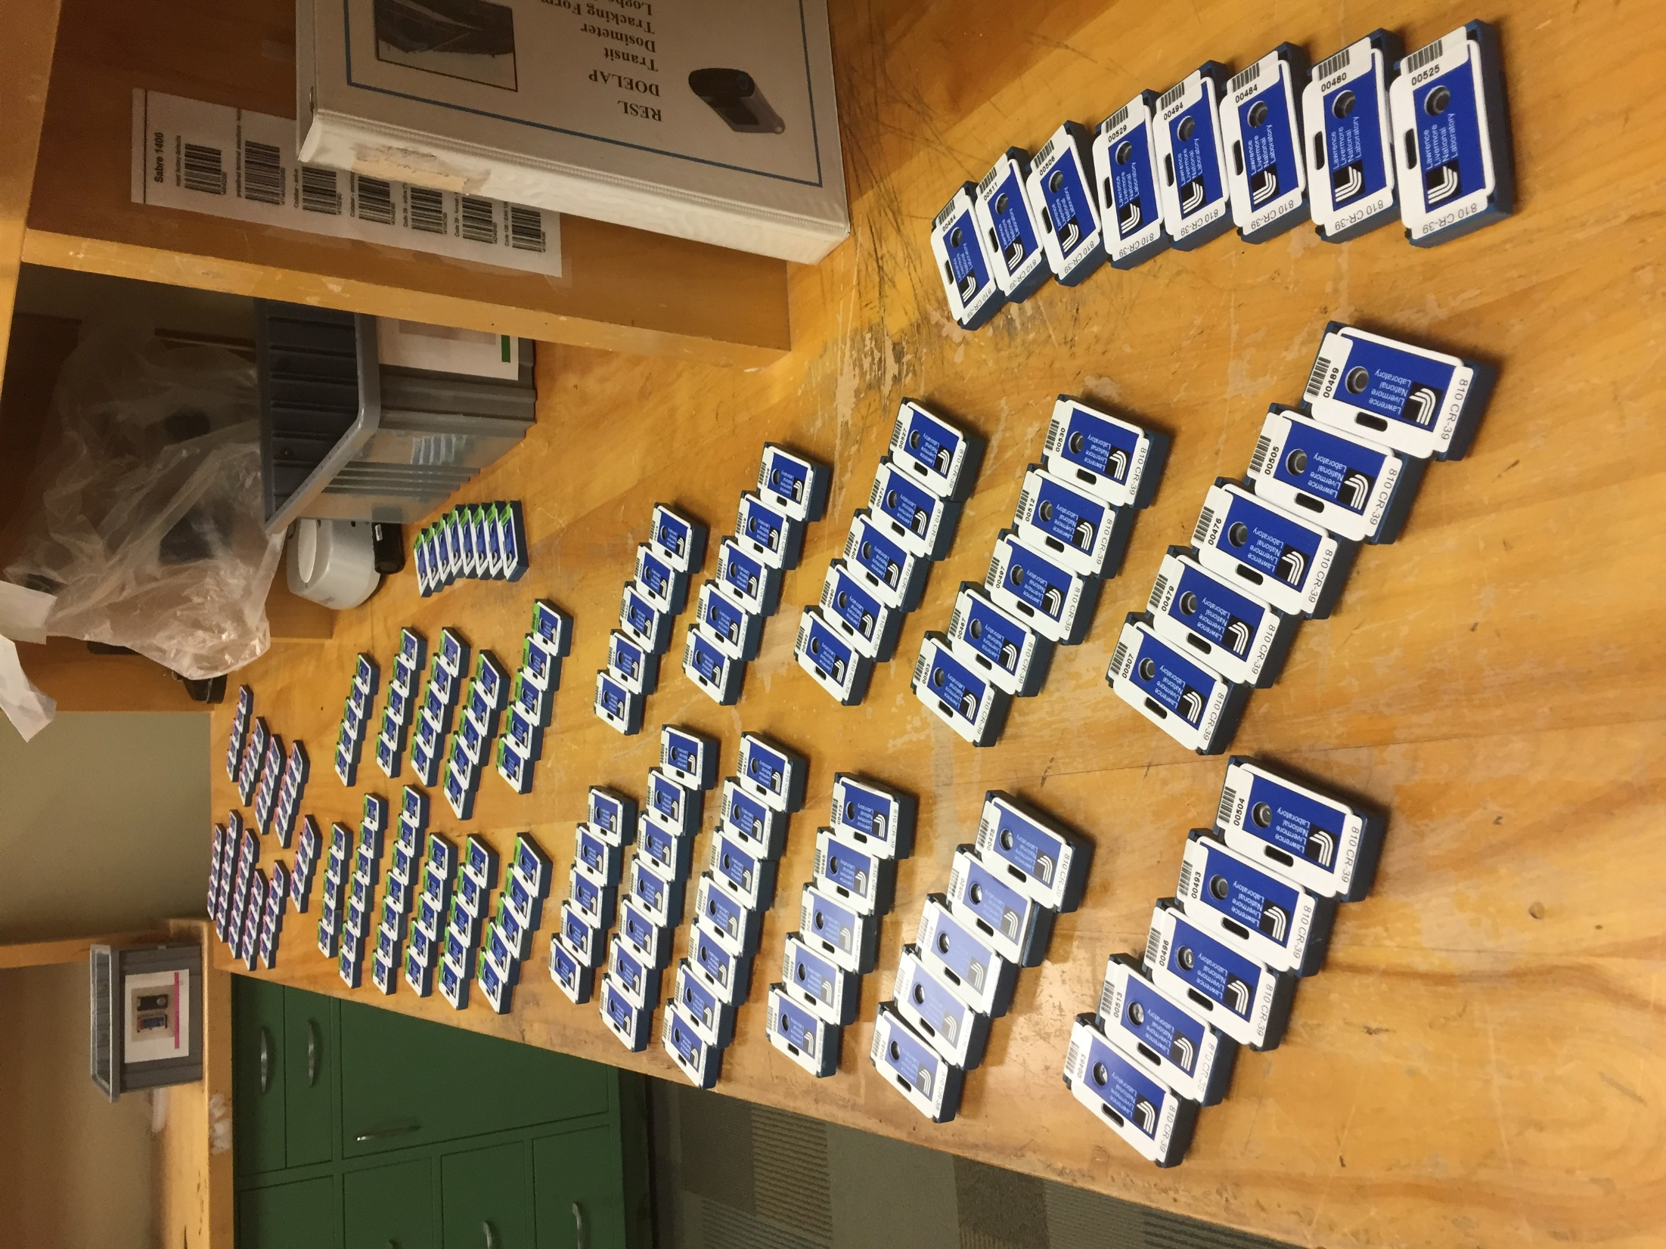

Slide 14
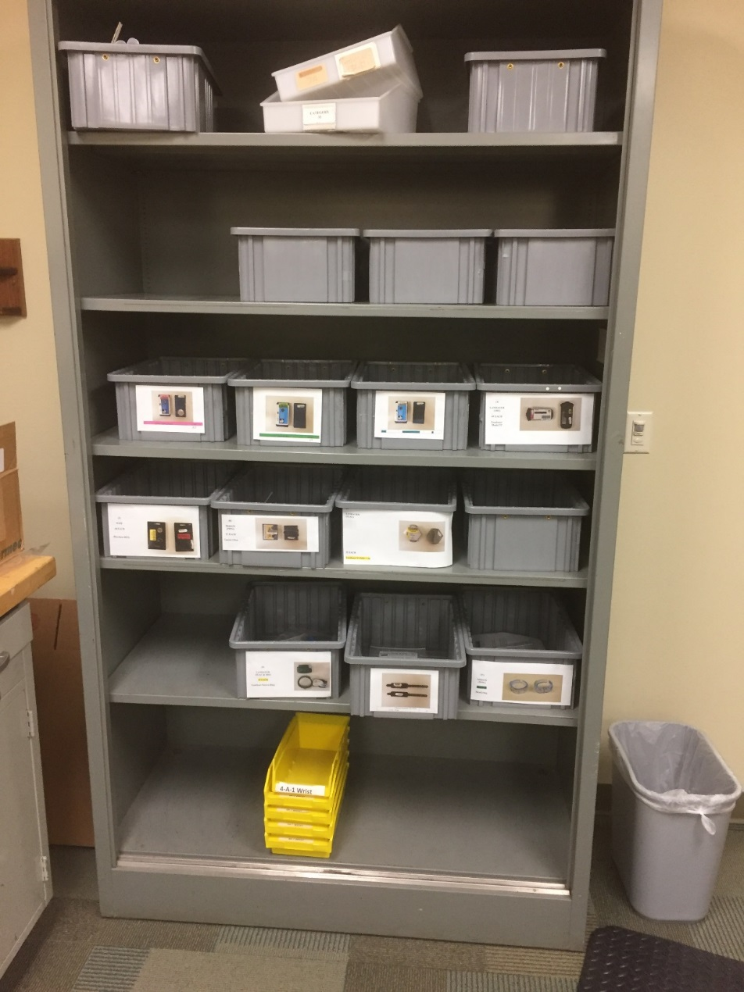
Receiving Dosimeters
Scan into database
Place in bins
  One for each Dosimeter Type

Slide 15
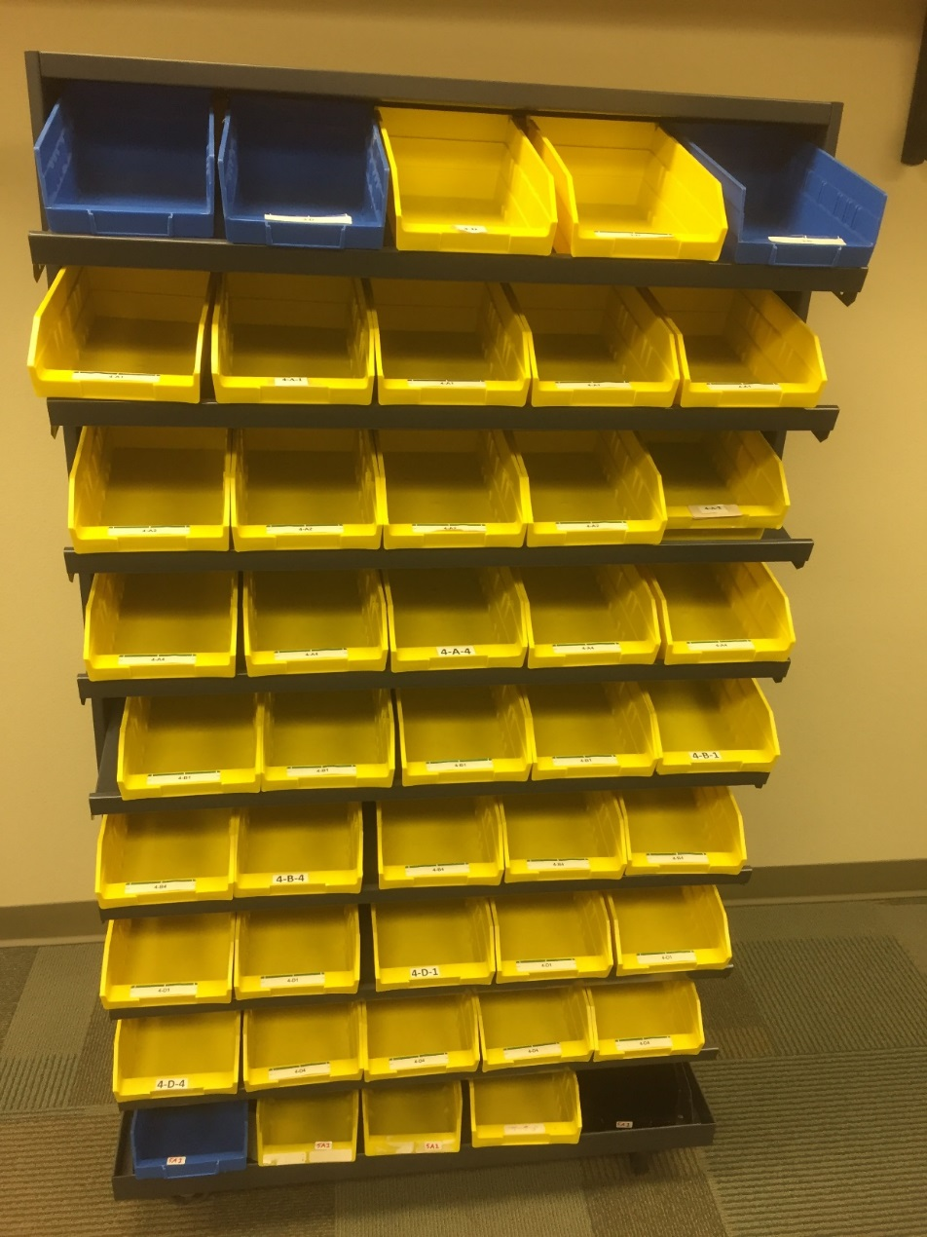
Dosimeter Handling
Scan dosimeters into categories
Place in boxes
Each box represents a single
Dose Assignment
More than 4 dosimeters will
result in multiple packets

Slide 16
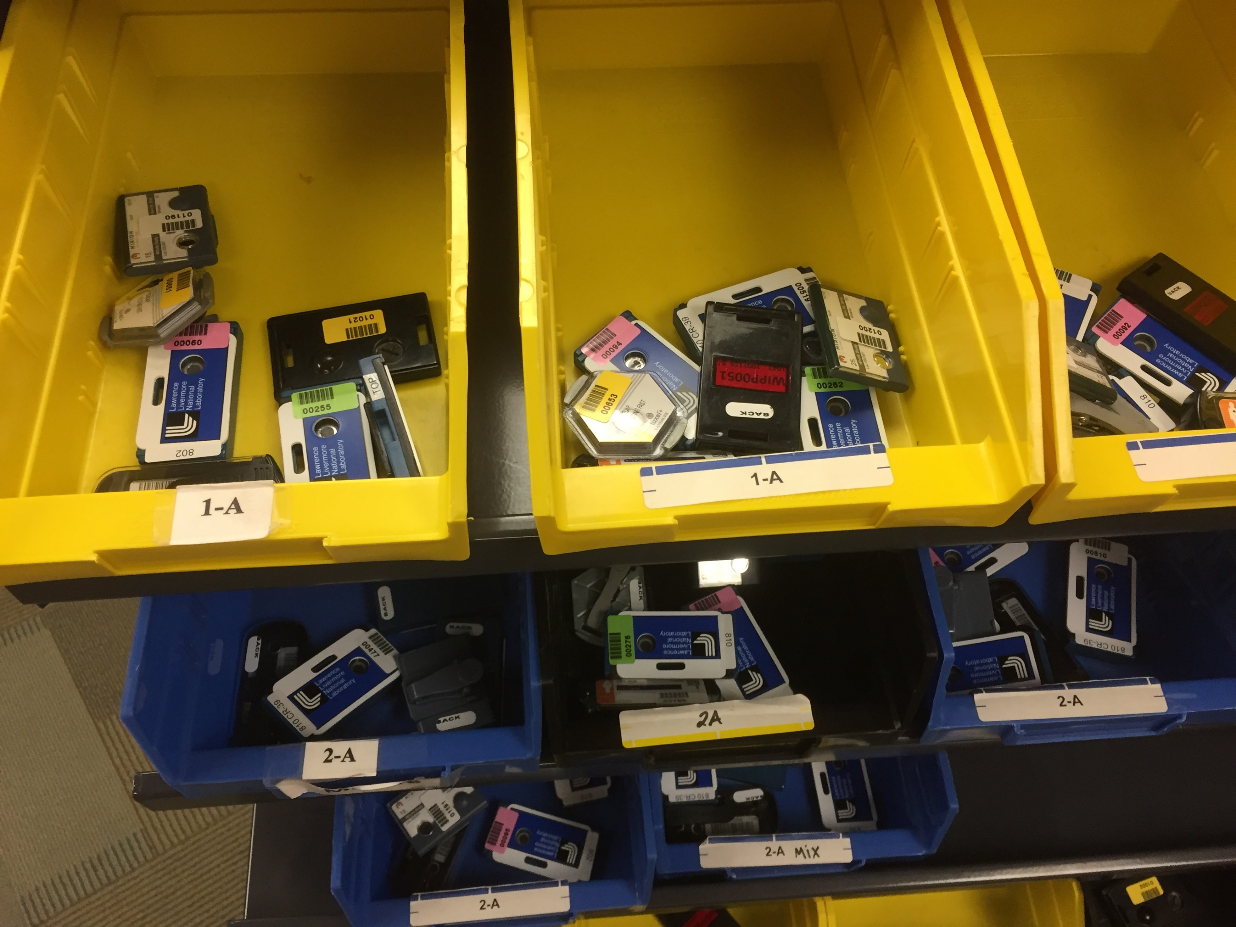

Slide 17
Building Packets
Maximum of 4 Participant Dosimeters per packet
1 RESL Irradiation Verification (IV) Dosimeter for each irradiation (2 for mixtures)

Slide 18
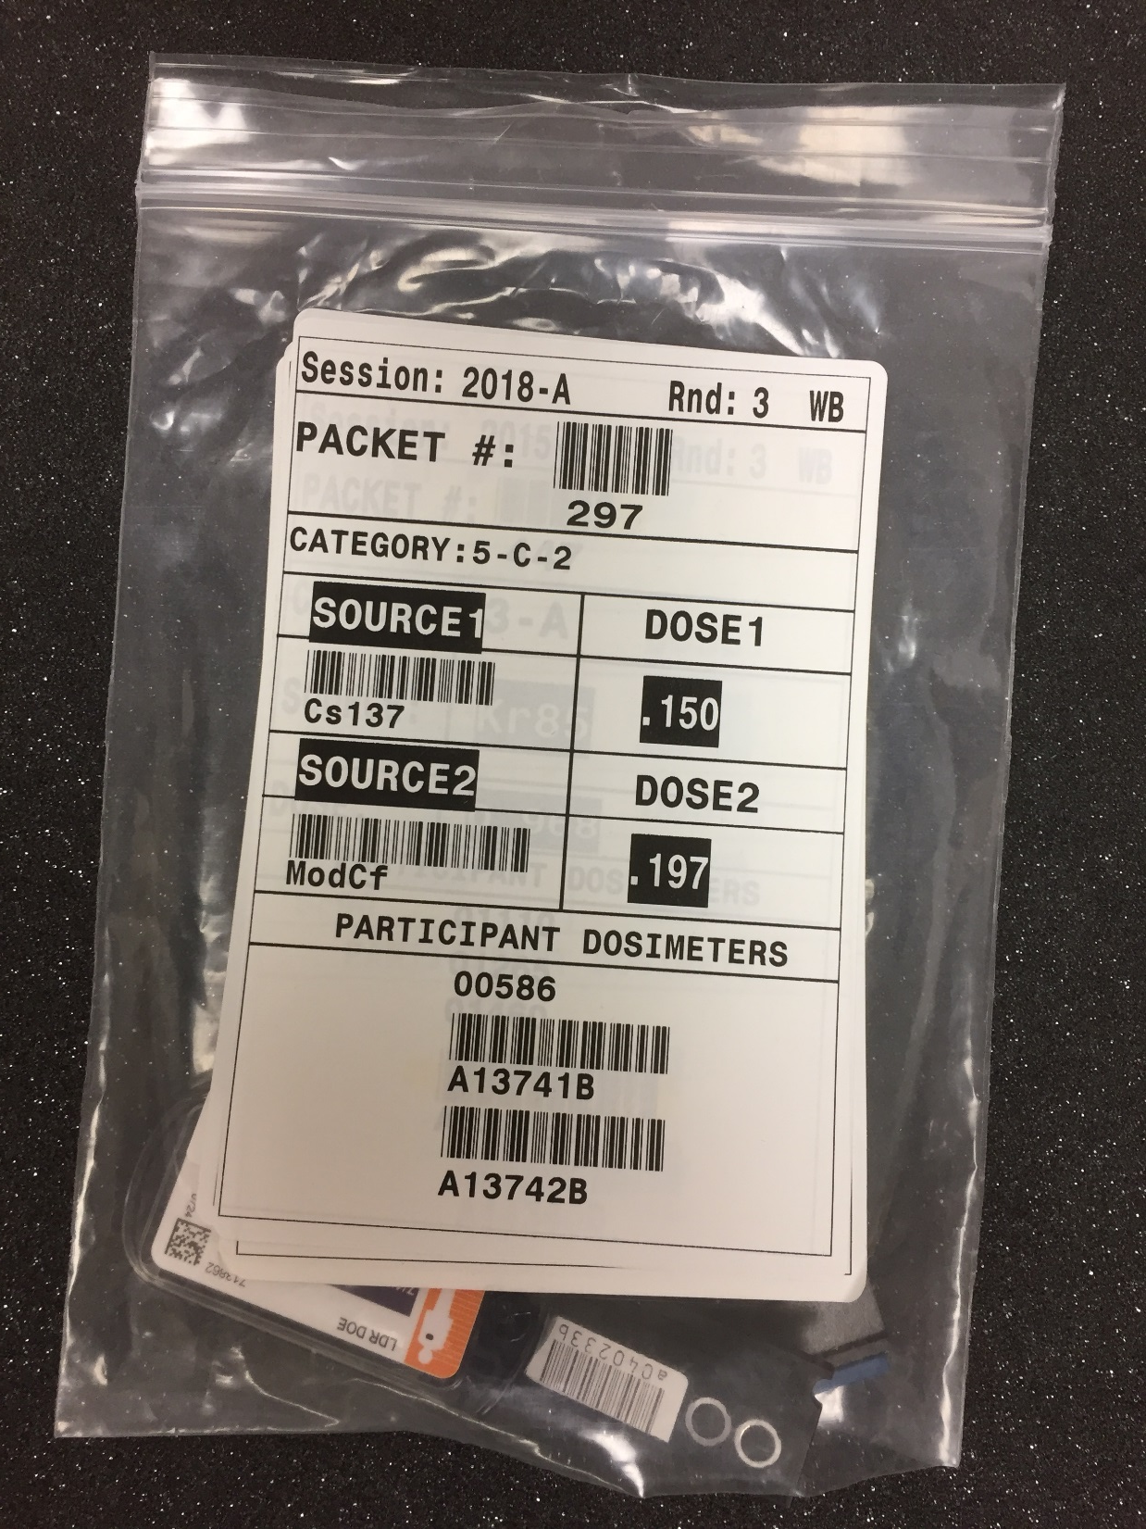

Slide 19
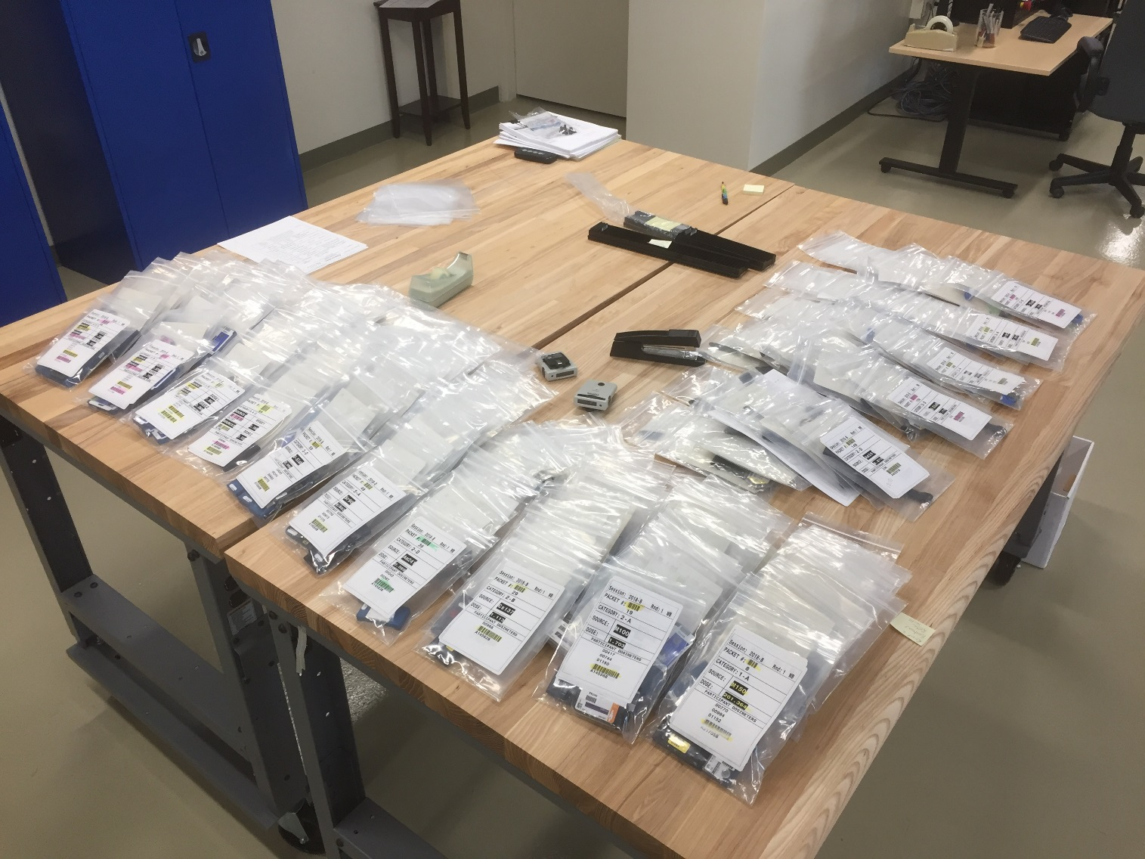
Packets Ready For Irradiation

Slide 20
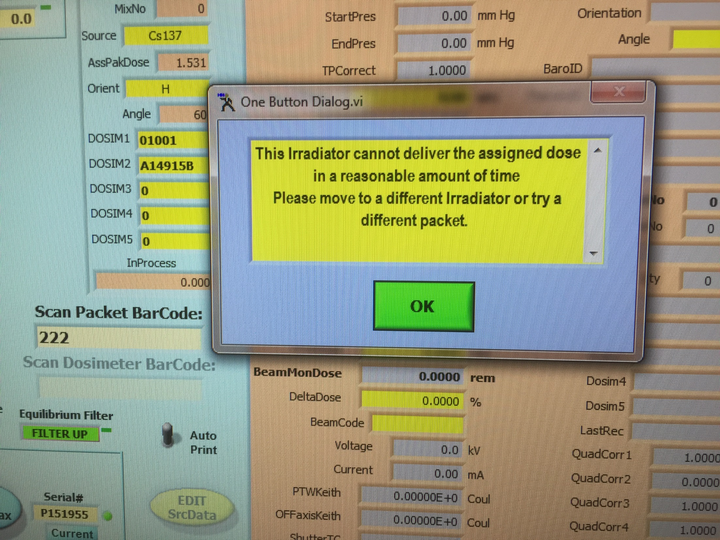

Slide 21
Returning Dosimeters
After the round of irradiations have been completed
  Packets are broken down
  Dosimeters are sorted by type
  Counted and surveyed
Shipped back to participants
Reporting Links are emailed to Participant
  One link for each dosimeter type tested
  Reported values can be changed until you hit ‘Submit’

Slide 22
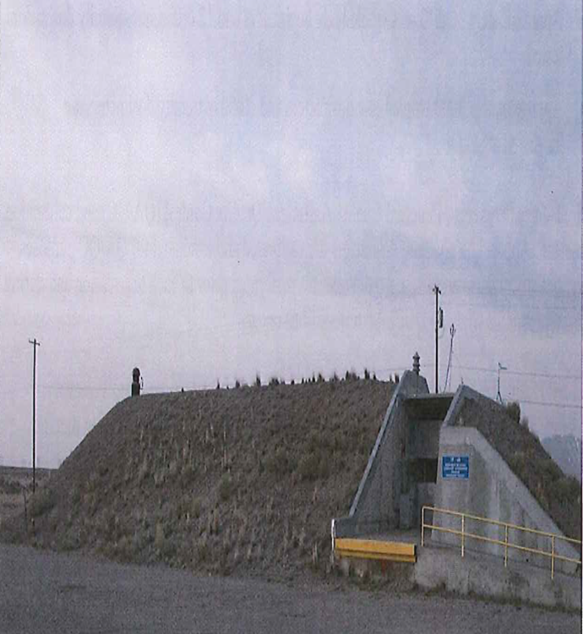
CFA-638 Irradiation Facility
Questions?

